Slide 1
Predictive Analysis of College Joining Probabilities Using Multivariate Factors
By :
JEGADEESH K
23MCM022
Guided By :
Dr VENKATA KRISHNA KUMAR S
Head of MSc Computer Science

Slide 2
Abstract
This project explores the predictive analysis of college joining probabilities based on multiple influencing factors. Utilizing a dataset encompassing various metrics such as Job Market Level, Education Level, Technologies, Political Stability, Natural Disasters, Infrastructures, Demographical Data, Feedbacks, Core Industry Data, and Trade Association Reports, this study aims to forecast the likelihood of students joining specific college streams across different states and districts in India.

Slide 3
Purpose of The Project
The findings of this study can aid educational institutions, policymakers, and stakeholders in understanding the key determinants influencing student enrollment, thereby enabling data-driven decision-making to enhance educational strategies and policies. The project highlights the importance of a multifactorial approach in predicting student behavior and offers a comprehensive framework for analyzing and improving college joining rates.

Slide 4
System Specifications
HARDWARE SPECIFICATIONS :
CPU : Intel core i3 or AMD equivalent
RAM : 4GB
STORAGE : 10 GB of free disk space.
GRAPHICS : Integrated GPU ( Intel HD Graphics 3000 or newer )
OS : Windows 7 or higher.

Slide 5



System Specifications
SOFTWARE SPECIFICATIONS :
PyCharm IDE
Google Colab
Microsoft Excel

Slide 6
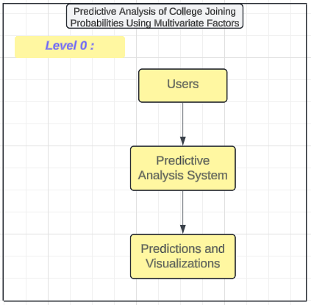
Data Flow Diagram

Slide 7
Thank You

